Slide 1
Work on Your ARM Strength
Automation is a critical factor in successful cloud projects. Successful projects are able to skillfully craft deployment templates and scripts that provision nearly all needed resources. While Azure Resource Manager (ARM) provides a robust “infrastructure as code” approach to managing Azure resources, getting started can seem like a daunting task. In this demo heavy session, we will dive deep into creating resources and manipulating ARM templates. We will review proven techniques you can apply to your Azure projects. In the end, you will have a series of tips you can use to unlock new and powerful ways to manage your Azure resources.

Slide 2
Work on Your ARM Strength
Michael S. Collier
Cloud Solution Architect, Microsoft

Slide 3
Michael S. Collier
Cloud Solution Architect, Microsoft
michael.collier@microsoft.com
michaelscollier@gmail.com
@MichaelCollier
www.MichaelSCollier.com
http://aka.ms/csablog
https://github.com/mcollier/StirTrek2016

Slide 4
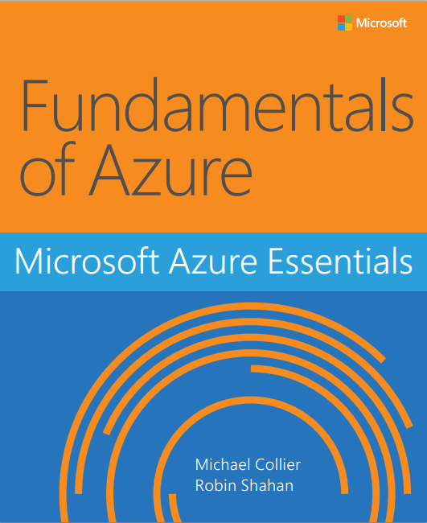
http://aka.ms/fundamentalsofazure

Slide 5



WHO: Cloud computing enthusiasts
WHAT: 1-day technical & business conference focused on the public & private cloud
WHEN: Friday, August 26th
WHERE: Ohio Union @ The Ohio State University
WHY: Learn, share, and network with local & regional professionals passionate about cloud computing
HOW: Speakers announced! Tickets on sale Monday, May 9th!!
http://www.clouddevelop.org
@CloudDevConf
http://www.facebook.com/CloudDevelop
Notes:
5th anniversary
Over 200 attendees in 2015
Over 20 sessions
Breakout and workshops

Slide 6

Today’s Agenda
Azure Resource Manager – Basics
Templates 101
Template Language Expressions
Advanced Template Concepts
Q&A

Slide 7
Azure Resource Manager
In 5 minutes or less . . . hopefully

Slide 8
Managing Azure Deployments
Azure Service Management (ASM / RDFE)
Traditional way to deploy and manage applications
Classic Azure Portal
PowerShell: {verb}-Azure{noun}
CLI: asm
Azure Resource Manager (ARM)
Modern way to deploy and manage applications / resources
Azure Portal (“Ibiza”)
PowerShell: {verb}-AzureRm{noun}
CLI: arm
✓
Notes:
Get-AzureVM
Get-AzureRmVm

Slide 9
ARM Definitions
Resource: Atomic unit of deployment
Resource Group: Collection of resources
Resource Provider: Manages specific kinds of resources
Resource Type: Specifies the type of resource
Notes:
Identified by provider namespace
e.g., Microsoft.Compute, Microsoft.Storage, Microsoft.Web (~ 30 Microsoft or customer namespaces)
Resource types
Each provider namespace manages one or more resource types
Microsoft.Compute/availabiltySets
Microsoft.Compute/virtualMachines
Microsoft.Compute/locations
Different regional availability and apiVersion
(Get-AzureRmResourceProvider –ProviderNamespace Microsoft.Compute).ResourceTypes

Slide 10
Benefits
Desired-state deployment
Faster deployment
Role-based access control (RBAC)
Resource-provider model
Orchestration
Resource configuration
SQL-A
Website
[SQL CONFIG] VM (2x)
DEPENDS ON SQL
DEPENDS ON SQL
SQL - A
Website
Virtual
Machines
SQL
C
ONFIG
Image source - http://channel9.msdn.com/Events/Build/2014/2-607
Notes:
Repeatedly provision resources

Slide 11
Consistent Management Layer
Tools
Azure Resource Manager
REST API
https://management.azure.com/subscriptions/{{subscriptionId}}/providers?api-version={{apiVersion}}
Provider Contract
Website
VM
SQL DB
Cache
…..
Resource Provider
?
Notes:
https://management.azure.com/subscriptions/{{subscriptionId}}/resourcegroups/{{resource-group}}/providers/Microsoft.Sql/servers/{{server}}/databases/{{database}}?api-version={{apiVersion}}

Slide 12
Templates 101
The Basics

Slide 13
Inside vs. Outside the box
ARM Template
PowerShell DSC
Chef
Puppet
Custom Script Ext (.ps1, .sh)

Slide 14
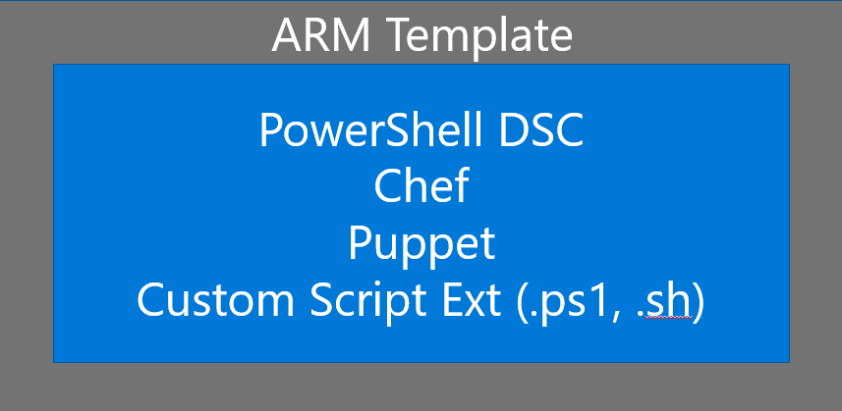
Inside vs. Outside the box
Outside – part of the template
VM, network topology, tags, RBAC, references to certs/secrets, etc.
Inside – executed by template only
Configure server roles, configure software, deploy a website, manage services, manage local users, etc.
Extensions for PowerShell DSC, Chef, Puppet, and custom scripts.
Notes:
ARM templates are for control things outside the VM – the VM itself and resources related to the deployment.
Inside – installed software and overall desired state. Scripts are executed by the ARM template but aren’t contained within the template itself.
DSC extensions can help to control “drift”.

Slide 15
The Basics
{
"$schema": "",
"contentVersion": "1.0.0.0",
"parameters":{},
"variables": {},
"resources": []
}

Slide 16
The Basics - Parameters
{
"$schema": "",
"contentVersion": "1.0.0.0",
"parameters":{
"adminUsername": {
"type": "string",
"minLength": 1
},
"windowsOSVersion": {
"type": "string",
"defaultValue": "2012-R2-Datacenter",
"allowedValues": [
"2008-R2-SP1",
"2012-Datacenter",
"2012-R2-Datacenter"
],
"metadata": {
"description": "The Windows version for the VM."
}
}},
}

Slide 17
The Basics - Variables
{
"$schema": "",
"contentVersion": "1.0.0.0",
"parameters":{…}
"variables": {
"imagePublisher": "MicrosoftWindowsServer",
"subnetName": "Subnet",
"virtualNetworkName": "MyVNET",
"vhdStorageType": "Standard_LRS",
"vhdStorageName": "[concat('vhdstorage', uniqueString(resourceGroup().id))]",
"vnetId": "[resourceId('Microsoft.Network/virtualNetworks', variables('virtualNetworkName'))]",
"subnetRef": "[concat(variables('vnetId'), '/subnets/', variables('subnetName'))]",},
}

Slide 18
The Basics - Resources
{
"$schema": "",
"contentVersion": "1.0.0.0",
"parameters":{…}
"variables": {…}
"resources": [
{
"type": "Microsoft.Storage/storageAccounts",
"name": "[variables('vhdStorageName')]",
"apiVersion": "2015-06-15",
"location": "[resourceGroup().location]",
"tags": {
"displayName": "StorageAccount"
},
"properties": {
"accountType": "[variables('vhdStorageType')]"
}
},
]
}

Slide 19
DSC Extension
{
"name": "DSCExt1",
"type": "extensions",
"location": "[resourceGroup().location]",
"apiVersion": "2015-05-01-preview",
"dependsOn": [
"[concat('Microsoft.Compute/virtualMachines/', parameters('vmName'))]"
],
"properties": {
"publisher": "Microsoft.Powershell",
"type": "DSC",
"typeHandlerVersion": "2.8",
"settings": {
"modulesUrl": "[parameters('modulesUrl')]",
"configurationFunction": "ConfigureWebServer.ps1\\Main",
"properties": {
"MachineName": "[parameters('vmName')]",
"WebDeployPackagePath": "[parameters('webdeploypkg')]",
"UserName": "[parameters('adminUserName')]",
"Password": "[parameters('adminPassword')]",
}
},
}
}
URL to DSC ZIP
URL to WebDeploy ZIP
URLs must be publically accessible (not local files)
* SAS Token

Slide 20
Export a Template
Build it in the Azure Portal?
Export it . . . FINALLY!
Export the resources in the selected resource group
Export the template from a previous deployment
Save it to a Templates gallery to share with others!

Slide 21
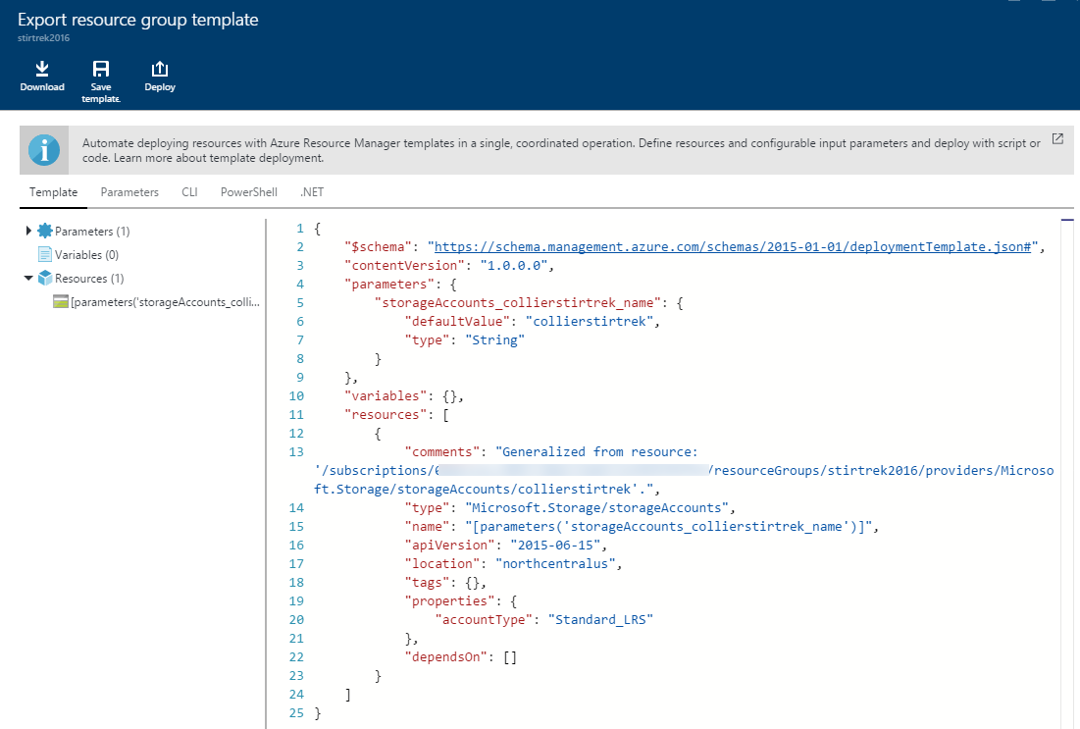
Export a Template
Build it in the Azure Portal
Export it . . . FINALLY!
Export the resources in the selected resource group
Export the template from a previous deployment
Save it to a Templates gallery to share with others!

Slide 22
Export a Template
Build it in the Azure Portal
Export it . . . FINALLY!
Export the resources in the selected resource group
Export the template from a previous deployment
Save it to a Templates gallery to share with others!

Slide 23
Export a Template
Build it in the Azure Portal
Export it . . . FINALLY!
Export the resources in the selected resource group
Export the template from a previous deployment
Save it to a Templates gallery to share with others!
> Export-AzureRmResourceGroup
-ResourceGroupName stirtrek2016 `
-Path c:\stirtrek2016.json `
-IncludeParameterDefaultValue -IncludeComments
> azure group export --name stirtrek2016 --directory c:\temp
--includeComments --includeParameterDefaultValue

Slide 24
Template Language Expressions
Building Blocks

Slide 25
Most Common
parameters('parameterName')
variables('variableName')
concat('string', 'to', 'join')
Usage
"variables":{
"authorizationHeader": "[concat('Basic ', base64(variables('password')))]
}

Slide 26
copyIndex()
"parameters": {
"numberOfInstances": {
"type": "int",
},
"resources":[
{
"apiVersion": "[variables('apiVersion')]",
"type": "Microsoft.Compute/virtualMachines",
"name": "[concat('myvm', copyIndex())]",
"location": "[variables('location')]",
"copy": {
"name": "virtualMachineLoop",
"count": "[parameters('numberOfInstances')]"
},
"dependsOn": [
"[concat('Microsoft.Network/networkInterfaces/', 'nic', copyindex())]",
"[concat('Microsoft.Storage/storageAccounts/', variables('storageAccountName'))]"
],
……
}
Create me N of these
myvm0
myvm1
….
myvmN
Notes:
https://azure.microsoft.com/en-us/documentation/articles/resource-group-create-multiple/
https://github.com/Azure/azure-quickstart-templates/blob/master/201-vm-copy-index-loops/azuredeploy.json

Slide 27
Other Functions
resourceGroup()
resourceId(‘provider/resourceType', 'resourceName')
listKeys('storageAccountResourceId', '2015-05-01')]
uniqueString(resourceGroup().id)]
toLower('mystring')
Complete list available at:
https://azure.microsoft.com/en-us/documentation/articles/resource-group-template-functions/

Slide 28
Your First Template
Let’s Do This!

Slide 29
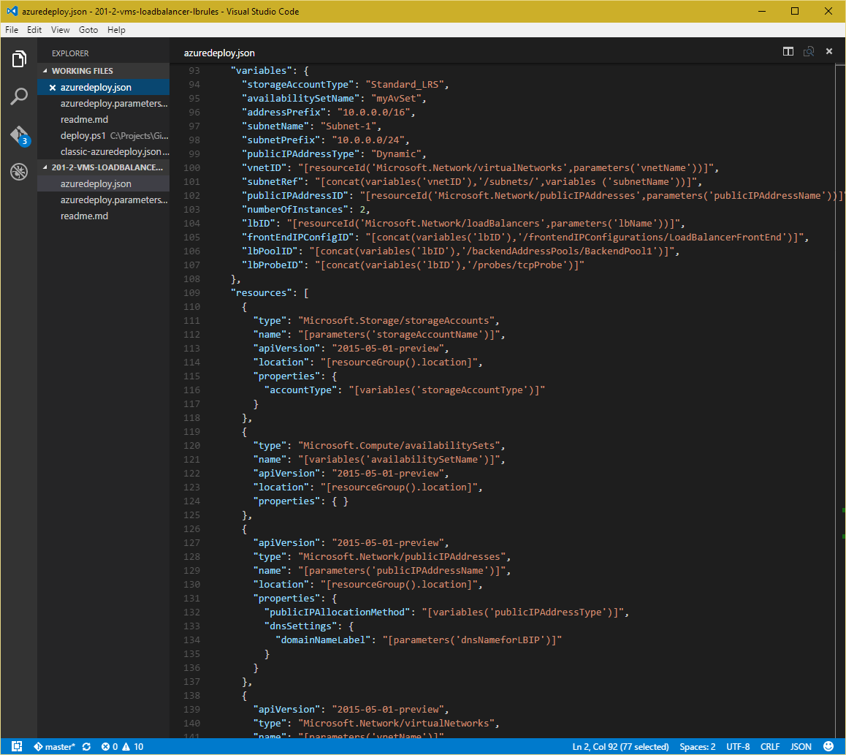
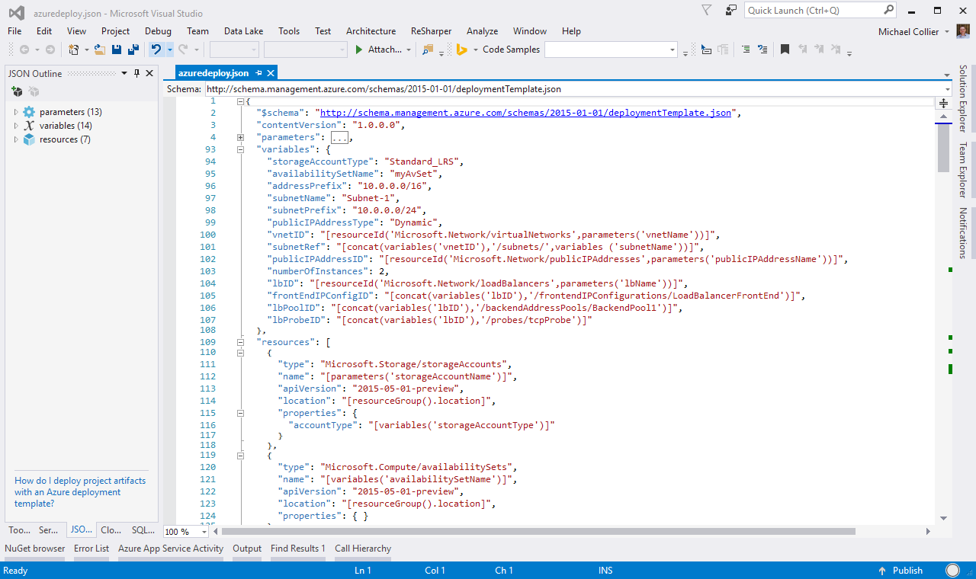

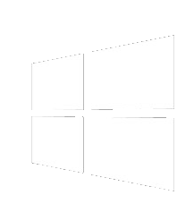


or
Any text editor!

Slide 30
Demo
Authoring a template with
Visual Studio or Visual Studio Code
Notes:
Create a basic Azure Web App (copy from pre-created version, show snippets in VSCode)
Open template in Visual Studio and show adding a new resource.
Deploy via PowerShell

Slide 31
Debugging
Oh &#!@$. . . Now we busted it! ☹

Slide 32
Debugging Templates
Template Validation
Tool with JSON validation (e.g. Visual Studio, Atom w/ JSONLint, etc.)
> Test-AzureRmResourceGroupDeployment
-ResourceGroupName stirtrek2016 `
-TemplateParameterFile .\azuredeploy.parameters.json `
-TemplateFile .\azuredeploy.json
> azure group template validate stirtrek2016 --template-file .\azuredeploy.json --parameters-file .\azuredeploy.parameters.json

Slide 33
Capture the Raw Request/Response
> $DebugPreference = ‘Continue’
> Start-Transcript c:\temp\output.txt
> {your command goes here}
> Stop-Transcript

Slide 34
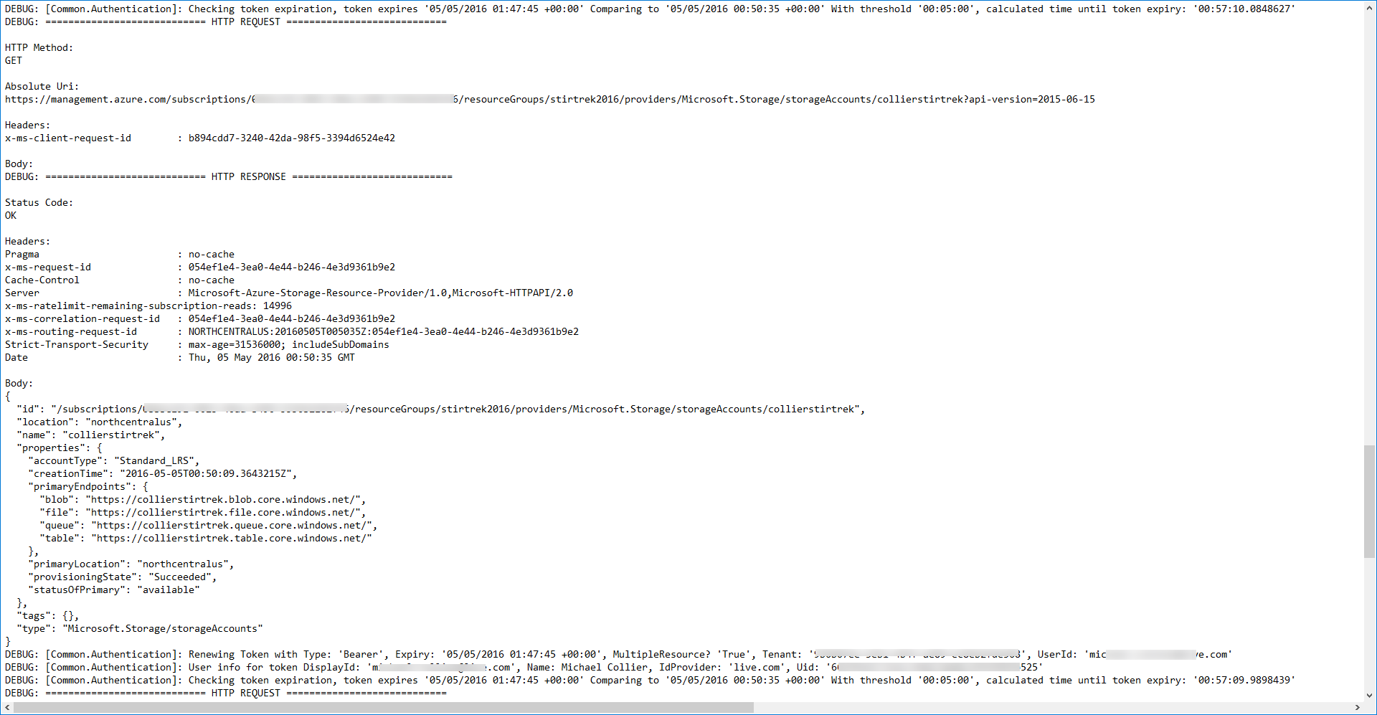
Capture the Raw Request/Response
> $DebugPreference = ‘Continue’
> Start-Transcript c:\temp\output.txt
> {your command goes here}
> Stop-Transcript

Slide 35
Deployment Debug Output
-DeploymentDebugLogLevel
New-AzureRmResourceGroupDeployment -ResourceGroupName $resourceGroupName `
-TemplateFile "azuredeploy.json" `
-TemplateParameterFile "azuredeploy.parameters.json" `
-DeploymentDebugLogLevel All `
-Verbose `
{ All | None | Request | Response }
> azure group deployment create --debug-setting RequestContent
{ All | None | RequestContent | ResponseContent }
Notes:
https://azure.microsoft.com/en-us/blog/debugging-arm-template-deployments/

Slide 36
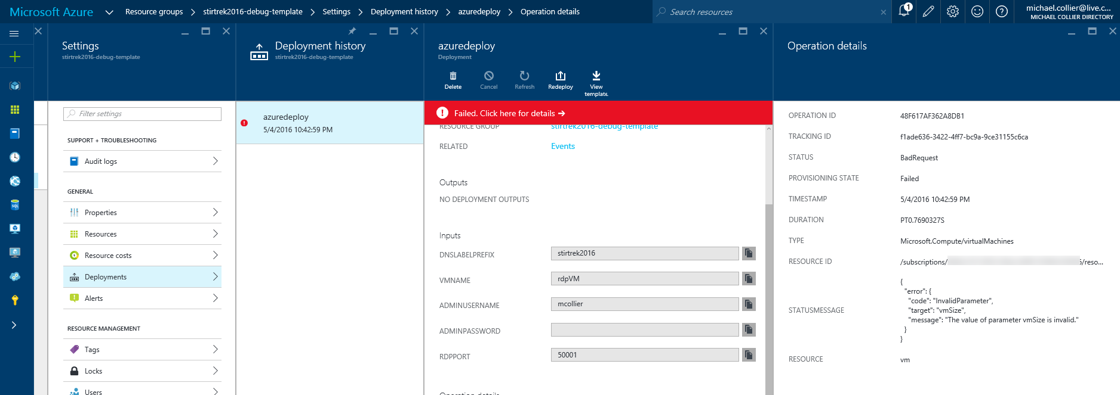
Resource Group Logging
Portal
PowerShell
CLI
Notes:
https://azure.microsoft.com/en-us/documentation/articles/resource-manager-troubleshoot-deployments-powershell/

Slide 37
Resource Group Logging
PowerShell
# Get logs for the resource group in the last 1 hour
Get-AzureRmLog -ResourceGroup $resourceGroupName
# Get logs for the resource group since a specific time
$startTime = (get-date).AddHours(-2).ToString('yyyy-MM-ddTHH:mm')
Get-AzureRmLog -ResourceGroup $resourceGroupName -StartTime $startTime
# Get the logs for a resource provider since a specific time
$startTime = (get-date).AddHours(-2).ToString('yyyy-MM-ddTHH:mm')
Get-AzureRmLog -ResourceProvider "Microsoft.Compute" -StartTime $startTime `
-Status Failed -DetailedOutput
Notes:
https://azure.microsoft.com/en-us/documentation/articles/resource-manager-troubleshoot-deployments-powershell/

Slide 38
Resource Group Logging
CLI
> azure group log show StirTrek2016 --json
> azure group deployment show --resource-group StirTrek2016 --name MyDeployment
> azure group deployment operation list --resource-group StirTrek2016 --name MyDeployment --json
Notes:
https://azure.microsoft.com/en-us/documentation/articles/resource-manager-troubleshoot-deployments-cli/

Slide 39
Advanced Templates
Finally!

Slide 40
Free Form . . . Ideal?
User selects arbitrary configuration
Number of nodes, VM sizes, disks, storage accounts, etc.
Maintenance overhead
Support for an undetermined number of configs
Subscription management
Resource limits per subscription
Density challenge – set aside capacity for potential use
Subscription creation cannot be automated

Slide 41
Known Configuration
T-Shirt Sizing
Size: Small, Medium, Large
Product/Audience: Community, Enterprise
Feature: Basic, High Availability
Flexibility within size to select number of resources (to max)
Known sizing – known resources

Slide 42
Template Decomposition
Parameters
adminUserName
adminPassword
storageAccountName
region
virtualNetworkName
addressPrefix
subnetName
subnetPrefix
jumpbox
tshirtSize
osFamily
Shared Resources Template
Template Metadata
Main Template
Optional Resource Template(s)
Known Configuration Resources Template
Widely Reusable Script(s)
Member Resources Template(s)
Custom Scripts
Image: https://azure.microsoft.com/en-us/documentation/articles/best-practices-resource-manager-design-templates/#identifying-what-is-outside-and-inside-of-a-vm

Slide 43
Objects
Ability to create loosely typed objects for passing between templates, or for organization.
"variables": {
"tshirtSize": "[variables(concat('tshirtSize', parameters('tshirtSize')))]",
"templateBaseUrl": "https://collierstirtrek.blob.core.windows.net/templates/",
"tshirtSizeSmall": {
"vmSize": "Standard_A1",
"vmTemplate": "[concat(variables('templateBaseUrl'), '2disk-resources.json')]",
"vmCount": 2,
"storage": {
"name": "[variables('storageAccountNameBase')]",
"count": 1
}
}
}
Usage
“[variables('tshirtSize').vmSize]”

Slide 44
Nesting
{
"name": "shared",
"type": "Microsoft.Resources/deployments",
"apiVersion": "2015-01-01",
"properties": {
"mode": "Incremental",
"templateLink": {
"uri": "[variables('sharedTemplateUrl')]",
"contentVersion": "1.0.0.0"
},
"parameters": {
"storageSettings": {
"value": "[variables('tshirtSize').storage]"
},
. . . .
}
}
}
URL to ARM template
URLs must be publically accessible (not local files)
* SAS Token

Slide 45
Demo
Walkthrough of a nested template.

Slide 46
Resources
ARM Quick Start Templates
https://azure.Microsoft.com/en-us/documentation/templates
https://github.com/Azure/azure-quick-start-templates
ARM Schemas
https://github.com/Azure/azure-resource-manager-schemas/tree/master/schemas
ARM Best Practices
https://azure.microsoft.com/en-us/documentation/articles/best-practices-resource-manager-design-templates/
Get the AzureCAT document!
ARM Visualizer
http://armviz.io
VS Code Extensions
https://github.com/Azure/azure-xplat-arm-tooling
https://github.com/mcollier/StirTrek2016

Slide 47
Questions?

Slide 48
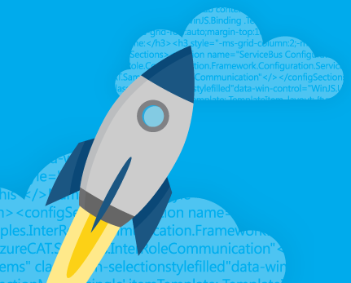
Thank You!
Michael S. Collier
@MichaelCollier | www.michaelscollier.com
michaelscollier@gmail.com | michael.collier@microsoft.com

Slide 49
Debugging
Now we did it!

Slide 50
Debugging Templates
Template Validation
Tool with JSON validation (e.g. Visual Studio, Atom w/ JSONLint, etc.)
> Test-AzureRmResourceGroupDeployment
-ResourceGroupName stirtrek2016 `
-TemplateParameterFile .\azuredeploy.parameters.json `
-TemplateFile .\azuredeploy.json
> azure group template validate stirtrek2016 --template-file .\azuredeploy.json --parameters-file .\azuredeploy.parameters.json

Slide 51
Capture the Raw Request/Response
> $DebugPreference = ‘Continue’
> Start-Transcript c:\temp\output.txt
> {your command goes here}
> Stop-Transcript

Slide 52
Capture the Raw Request/Response
> $DebugPreference = ‘Continue’
> Start-Transcript c:\temp\output.txt
> {your command goes here}
> Stop-Transcript

Slide 53
Verbose and Debug Output
- Verbose
> PS C:\Users\mcollier> C:\DebugExample\Deploy-Template.ps1
………
VERBOSE: 10:42:28 PM - Template is valid.
VERBOSE: 10:42:29 PM - Create template deployment 'azuredeploy'.
VERBOSE: 10:42:40 PM - Resource Microsoft.Storage/storageAccounts 'd6mwa2w3sjc62sardpvm' provisioning status is running
VERBOSE: 10:42:40 PM - Resource Microsoft.Network/publicIPAddresses 'publicIp' provisioning status is running
VERBOSE: 10:42:40 PM - Resource Microsoft.Network/virtualNetworks 'rdpVNET' provisioning status is running
VERBOSE: 10:42:50 PM - Resource Microsoft.Network/networkInterfaces 'rdpVM-nic' provisioning status is succeeded
VERBOSE: 10:42:50 PM - Resource Microsoft.Network/loadBalancers 'loadBalancer' provisioning status is succeeded
VERBOSE: 10:42:50 PM - Resource Microsoft.Network/publicIPAddresses 'publicIp' provisioning status is succeeded
VERBOSE: 10:42:50 PM - Resource Microsoft.Network/virtualNetworks 'rdpVNET' provisioning status is succeeded
{ All | None | Request | Response }
Notes:
https://azure.microsoft.com/en-us/blog/debugging-arm-template-deployments/

Slide 54
Verbose and Debug Output
-DeploymentDebugLogLevel
New-AzureRmResourceGroupDeployment -ResourceGroupName $resourceGroupName `
-TemplateFile "azuredeploy.json" `
-TemplateParameterFile "azuredeploy.parameters.json" `
-Verbose `
-DeploymentDebugLogLevel All
{ All | None | Request | Response }
> azure group deployment create --debug-setting RequestContent
{ All | None | RequestContent | ResponseContent }
Notes:
https://azure.microsoft.com/en-us/blog/debugging-arm-template-deployments/

Slide 55
Demo
Debug Logging
Notes:
Run Demo-Debugging\Deploy-Template.ps1 script

Slide 56
Resource Group Logging
Portal
PowerShell
CLI
Notes:
https://azure.microsoft.com/en-us/documentation/articles/resource-manager-troubleshoot-deployments-powershell/

Slide 57
Resource Group Logging
PowerShell
CLI
# Get logs for the resource group in the last 1 hour
Get-AzureRmLog -ResourceGroup $resourceGroupName
# Get logs for the resource group since a specific time
$startTime = (get-date).AddHours(-2).ToString('yyyy-MM-ddTHH:mm')
Get-AzureRmLog -ResourceGroup $resourceGroupName -StartTime $startTime
# Get the logs for a resource provider since a specific time
$startTime = (get-date).AddHours(-2).ToString('yyyy-MM-ddTHH:mm')
Get-AzureRmLog -ResourceProvider "Microsoft.Compute" -StartTime $startTime `
-Status Failed -DetailedOutput
> azure group deployment create --debug-setting RequestContent
Notes:
https://azure.microsoft.com/en-us/documentation/articles/resource-manager-troubleshoot-deployments-powershell/

Slide 58
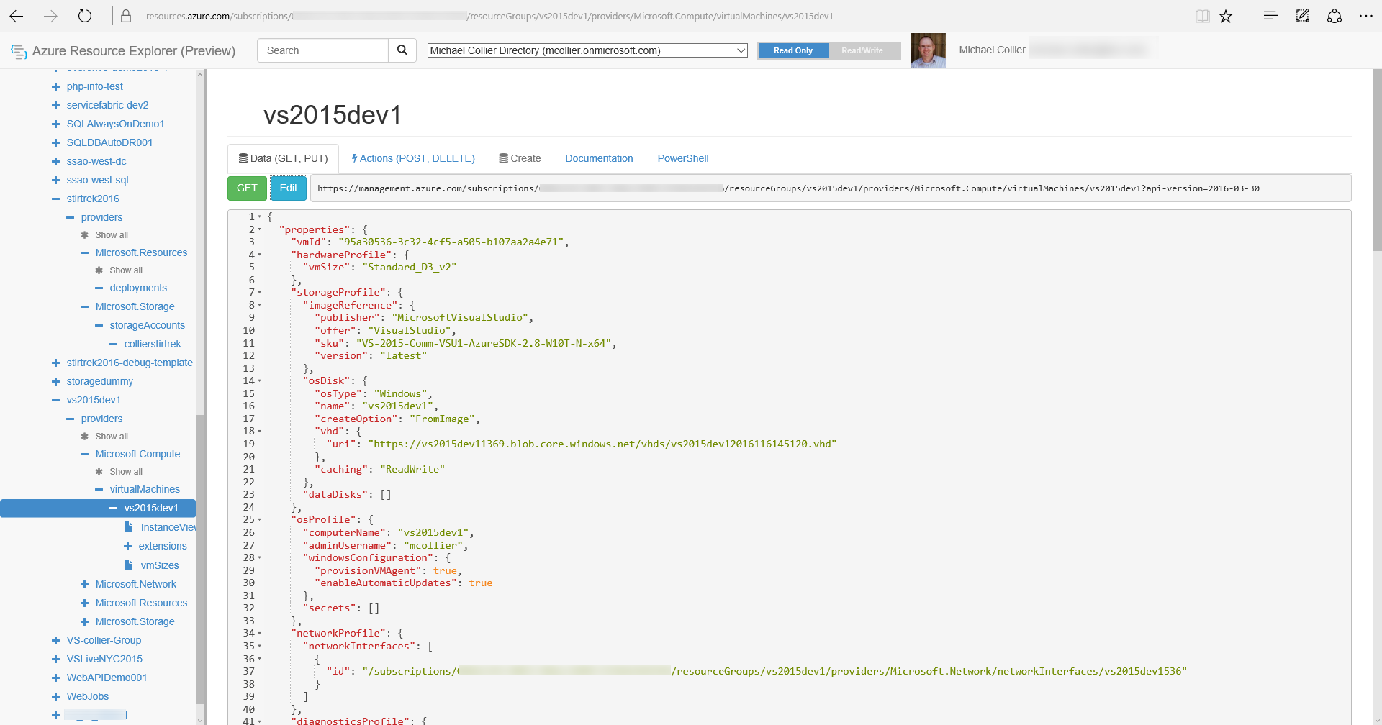
Azure Rest API Explorer
https://resources.azure.com

Slide 59
Azure Resource Manager
What is Azure Resource Manager?
Unit of Management
Lifecycle
RBAC
Costs
One Resource -> One Resource Group
Resource Group
Notes:
Resource - an Azure entity such as a VM, WebSite, Storage Account, SQL Database
Resource Group
Collection of Azure resources
Every Resource must exist in one, and only one, Resource Group
Unit of Management
Lifecyle - deployment, update, delete, obtain status
Grouping - Billing

Slide 60
Resource Providers
Deploy specific types of resources
Identified by provider namespace
e.g., Microsoft.Compute, Microsoft.Storage, Microsoft.Web (~ 30 Microsoft or customer namespaces)
Resource types
Each provider namespace manages one or more resource types
Microsoft.Compute/availabiltySets
Microsoft.Compute/virtualMachines
Microsoft.Compute/locations
Different regional availability and apiVersion
(Get-AzureRmResourceProvider –ProviderNamespace Microsoft.Compute).ResourceTypes

Slide 61
Locks
Prevents deletion of a resource or resource group
Associate a resource lock with the resource or resource group
Only the Owner or User Access Administrator roles can create or modify locks
code
Notes:
Can also do this with PowerShell.
https://azure.microsoft.com/en-us/documentation/articles/resource-group-lock-resources/

Slide 62
Buddies

Slide 63
Policies
blah
foobar
code
Notes:
https://github.com/cyl3392207/msblogs/tree/master/policyexamples

Slide 64
quotoa
Get-AzureRmVmUsage

Slide 65
Demo
Walkthrough Azure REST API Explorer debugging

Slide 66
Model Differences
Classic (v1)
Resource Manager (v2)
diagram
diagram

Slide 67
Data Plane vs. Control Plane
Control Plane Operations
Operations against the management plane
Create or Restart a VM
Update a Virtual Network
Create a Storage Account
Data Plane Operations
Operations that don’t go through the control plane
Accessing a web site
Copying blobs between storage accounts

Slide 68
Azure Resource Groups
Lifecycle of application and resources
Declarative
Consistent Management API
Resource Group
Notes:
Lifecycle of application and related resources

Slide 69
Azure Resource Manager
What is Azure Resource Manager?
Unit of Management
Lifecycle
Identity
Grouping
One Resource -> One Resource Group
Resource Group
Notes:
Resource - an Azure entity such as a VM, WebSite, Storage Account, SQL Database
Resource Group
Collection of Azure resources
Every Resource must exist in one, and only one, Resource Group
Unit of Management
Lifecyle - deployment, update, delete, obtain status
Grouping - Billing

Slide 70
Resource Groups
One or Many?
Resource Group
Resource Group
Resource Group
How are the resources managed?

Slide 71
Discover Templates
The Foundation

Slide 72
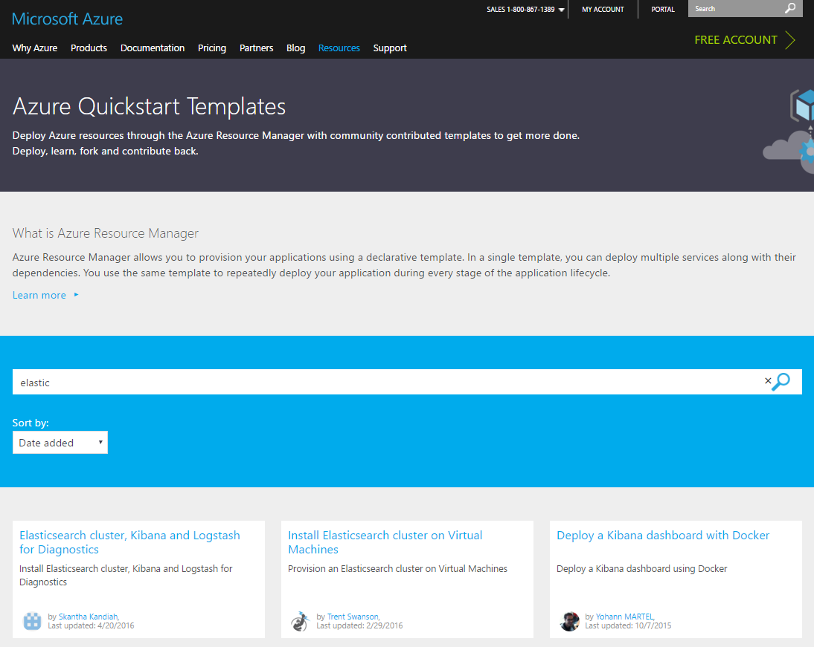
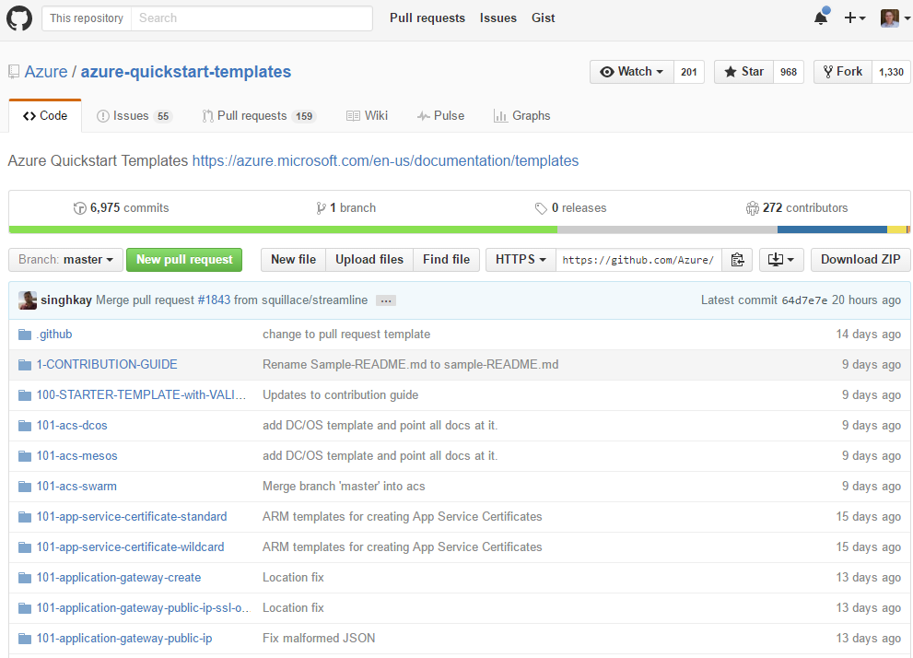
screenshot
screenshot
Azure.com
https://azure.Microsoft.com/en-us/documentation/templates/
Azure.com → Resources → Templates
Github
https://github.com/Azure/azure-quick-start-templates

Slide 73
Demo
Deploy from PowerShell and
Azure CLI

Slide 74
Template Decomposition
Parameters
adminUserName
adminPassword
storageAccountName
region
virtualNetworkName
addressPrefix
subnetName
subnetPrefix
jumpbox
tshirtSize
osFamily
Main Template
Optional Resource Template(s)
Known Configuration Resources Template
Image: https://azure.microsoft.com/en-us/documentation/articles/best-practices-resource-manager-design-templates/#identifying-what-is-outside-and-inside-of-a-vm

